Slide 1

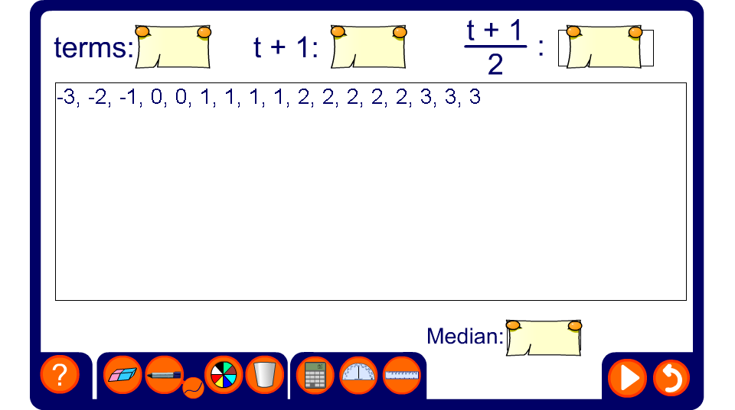


Where is the median?
Notes:
Discuss how to find the median; press reset to use a new data set. Sometimes there will be an odd number and sometimes an even number of items.

